Slide 1


EagleSat ll Memory Degradation Experiment (MDE)
By Shane Howe
Mentor: Ahmed Sulyman (Embry Riddle)
Tucson Arizona
4/25/22

Slide 2

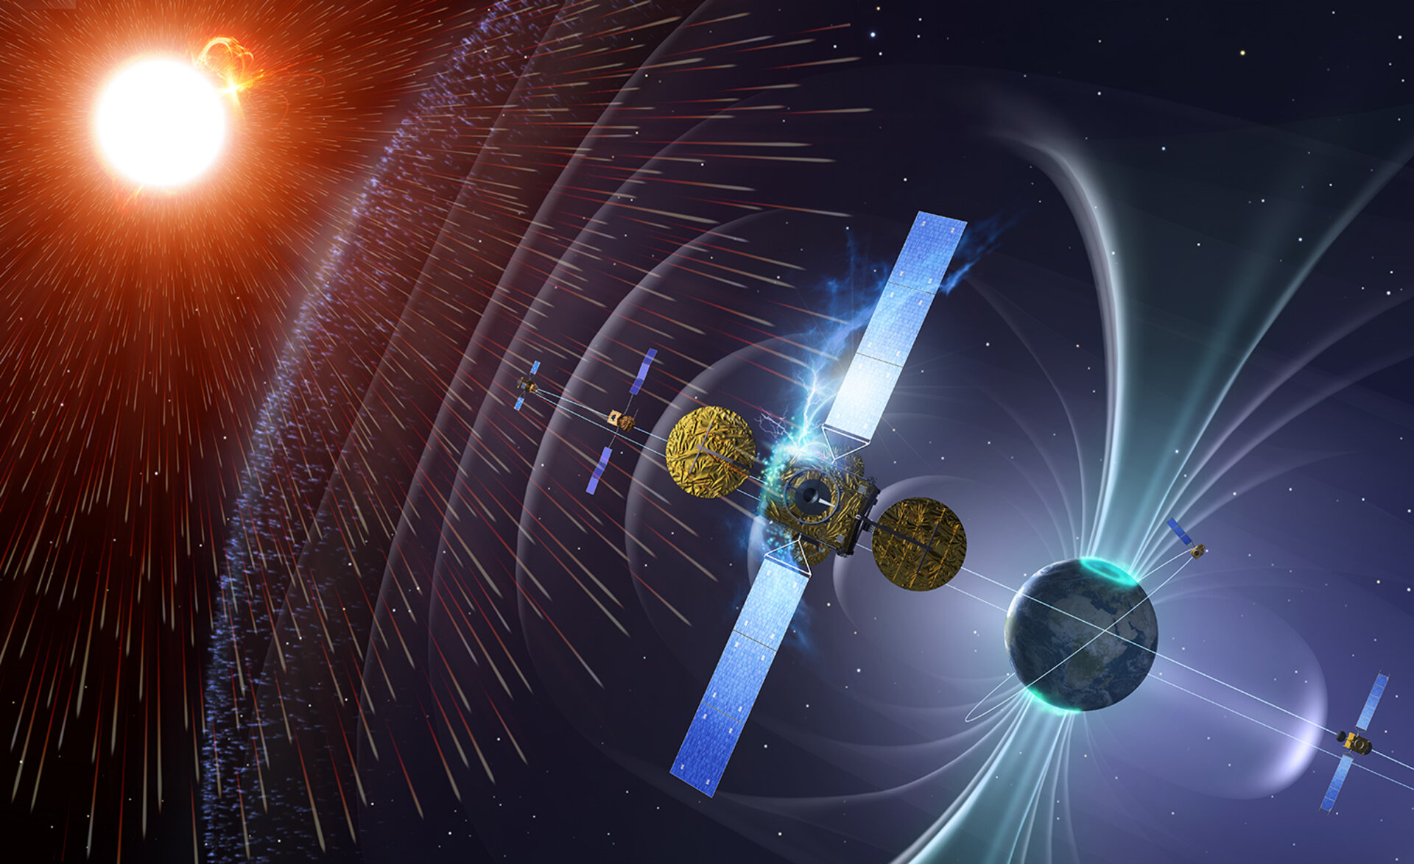
What are we Testing?
Types of space radiation:
Galactic Cosmic Rays
Solar Particles
Radiation in Earth’s Magnetic Field
Reactions caused by radiation
Short term bit flips
Long term damage

Slide 3
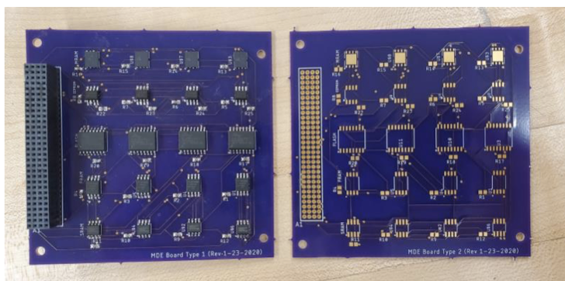
Types of Memory Used in Testing
EEPROM (Electronically Erasable Programable Read Only Memory)
MRAM (Magneto resistive RAM)
FRAM (Ferroelectric RAM)
SRAM (Static RAM)
Flash memory

Slide 4
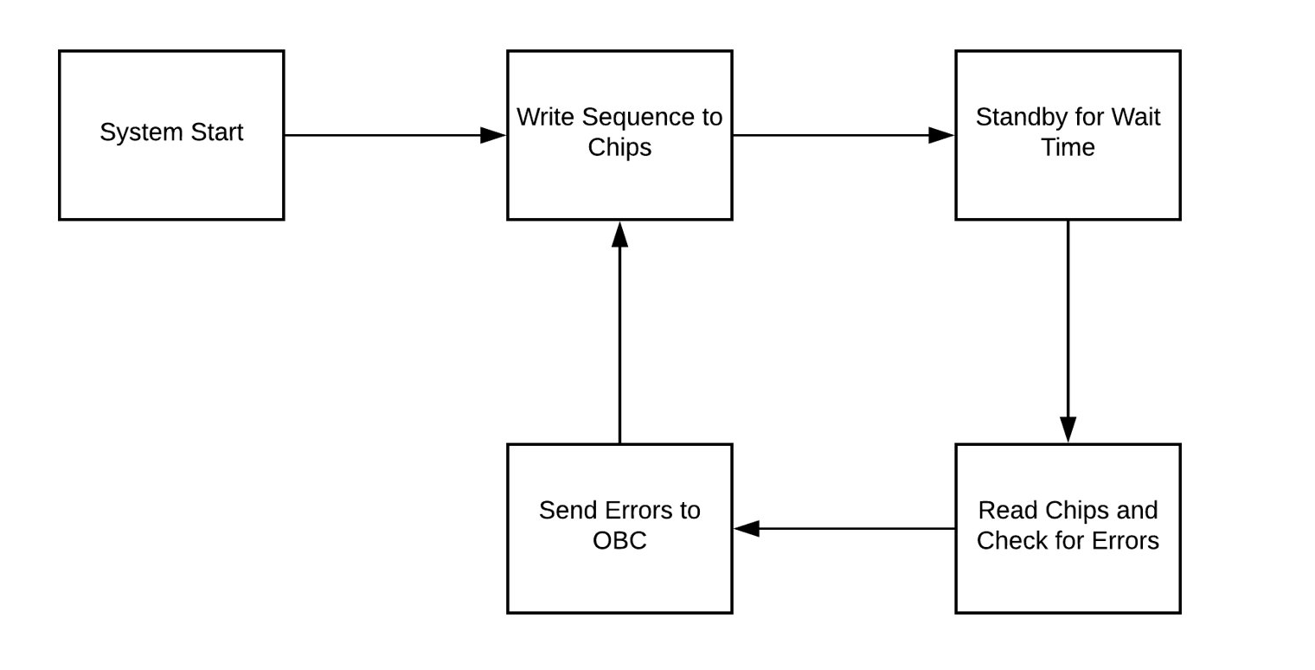
How it works

Slide 5
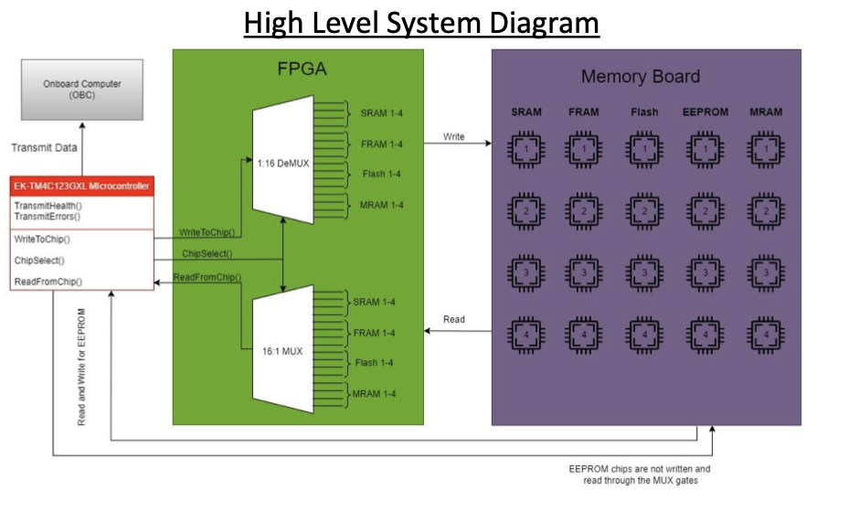

Slide 6
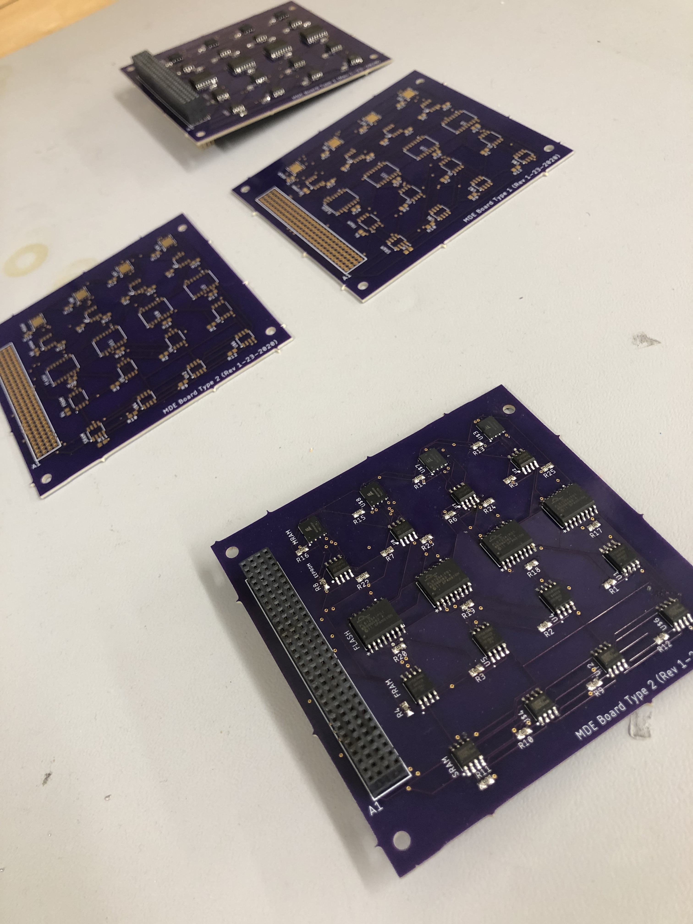
Where are we at?
Done with coding
Finishing Board design by making them more efficient
Eaglesat ll is set to launch December

Slide 7
On Ground testing
Identical copy of flight module to run on the ground for the duration of the mission​
Ideally, any non-radiation errors will occur similarly on the ground as in orbit​
Differences in chips may cause differences in non-radiation errors​
Provides additional error rate data for radiation levels on the ground

Slide 8
Thank You

Slide 9
Shane Howe
Howes3@my.erau.edu

